Slide 1
Corn Hole Project and
Parking Lot Phase 2
BY: Eric Evans

Slide 2
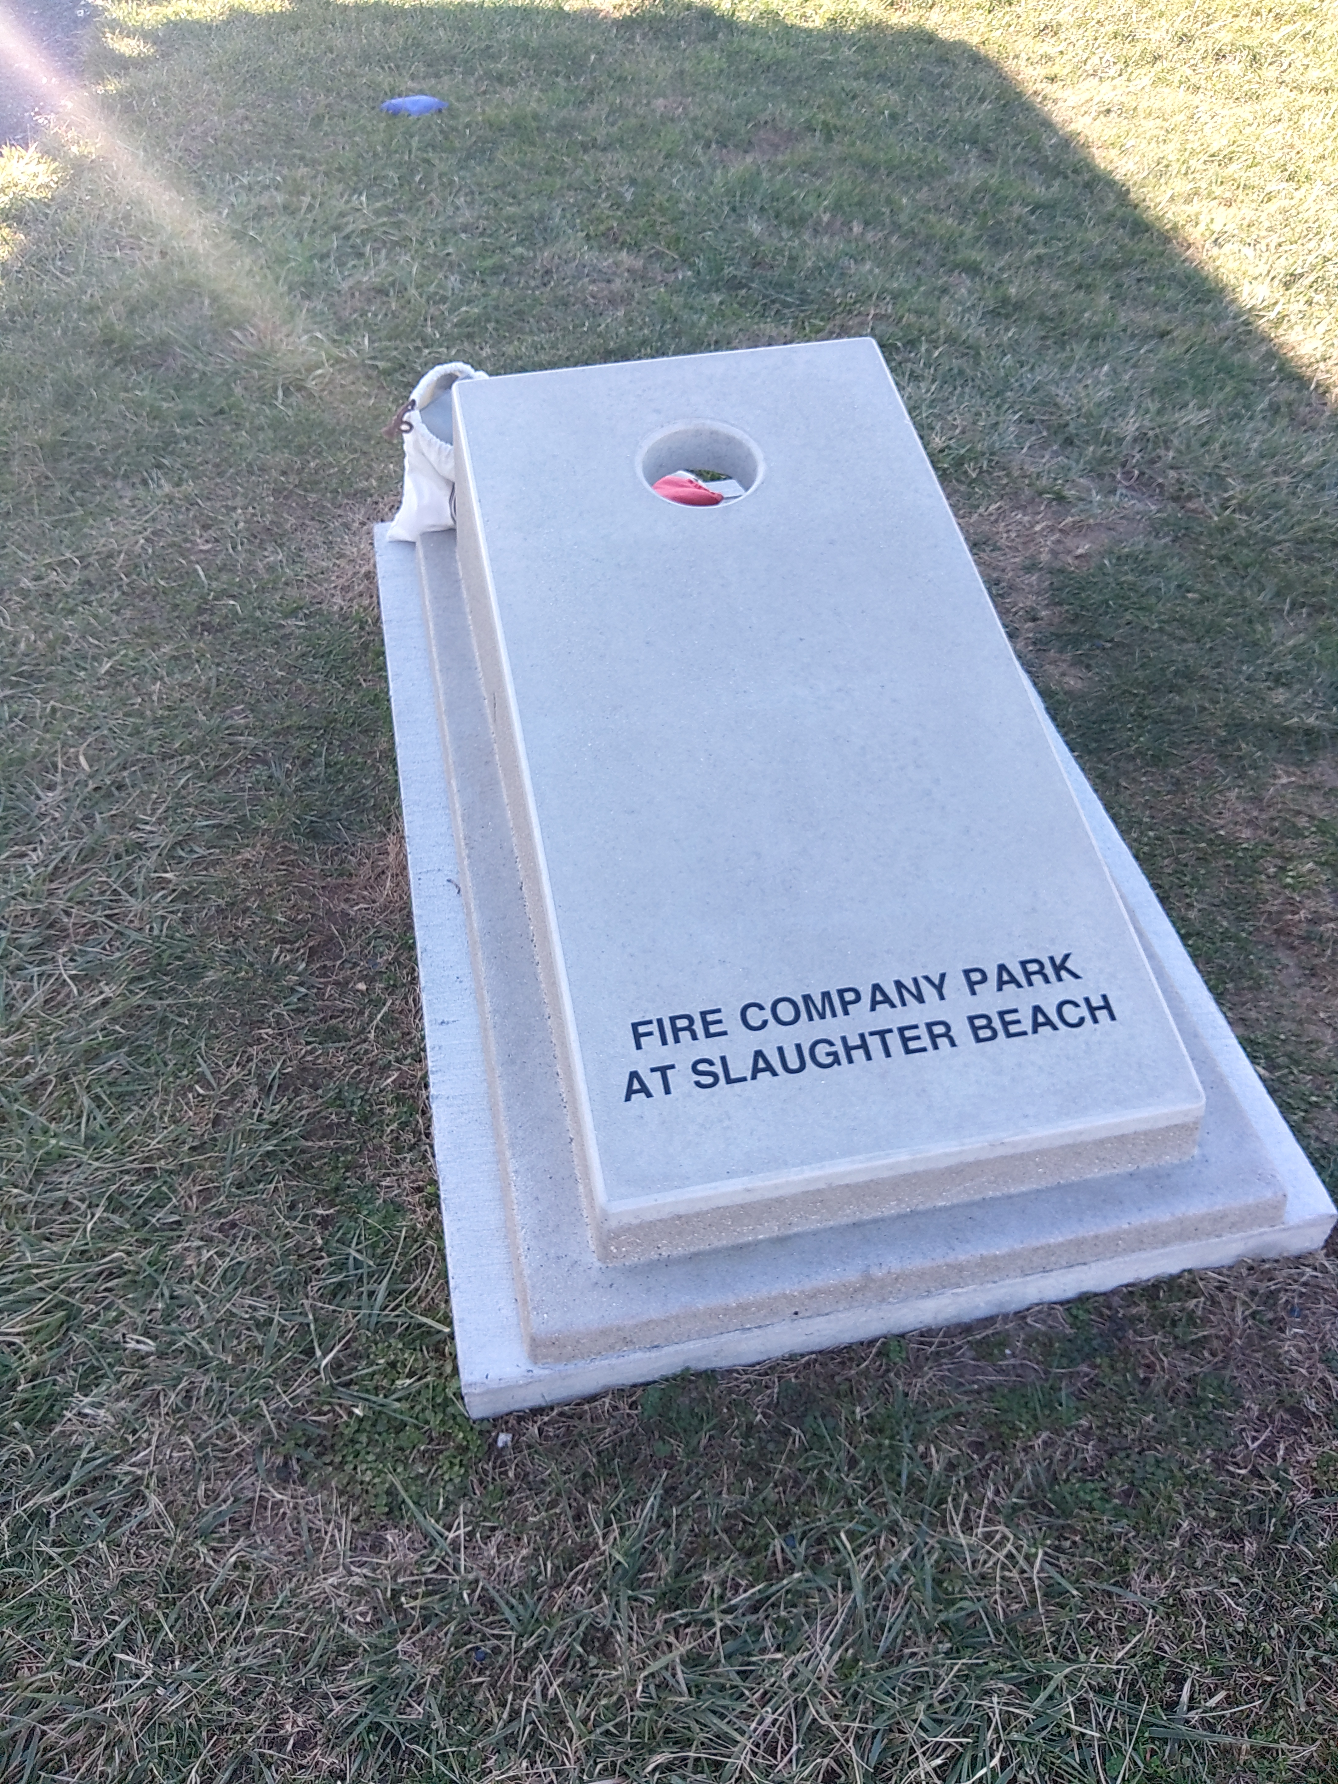
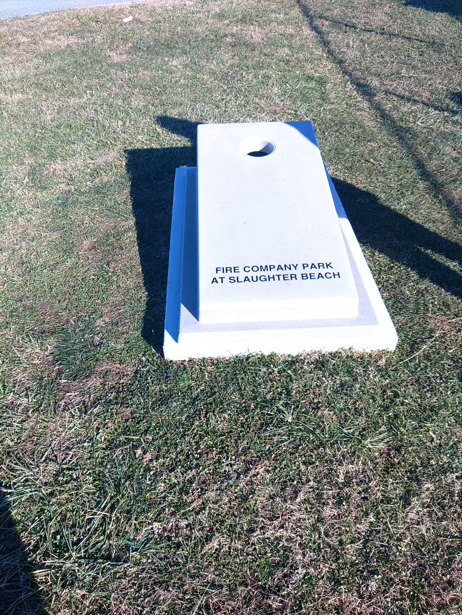
CORN HOLE PROJECT
Samples shown.
Concrete for durability
Town of Millville stamp on it.
Two Courts to be installed
Cement walkways attach everything. No trimming needed.
4-foot walkways to accommodate wheelchairs.
Weigh 600 Pounds.
Approximate Cost Less than $15,000.

Slide 3
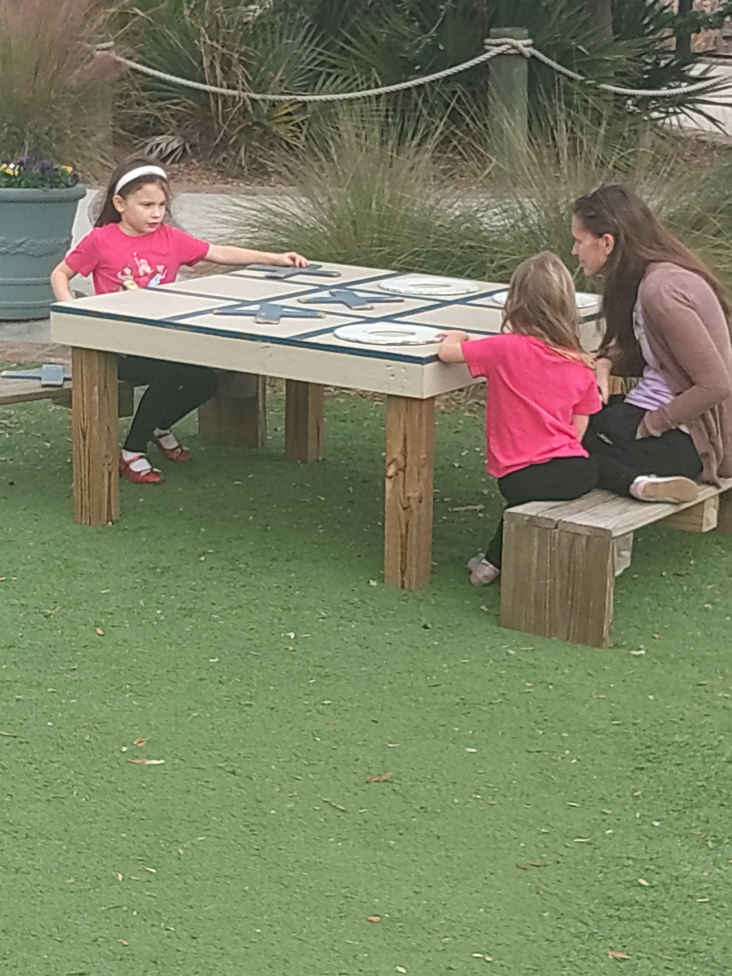
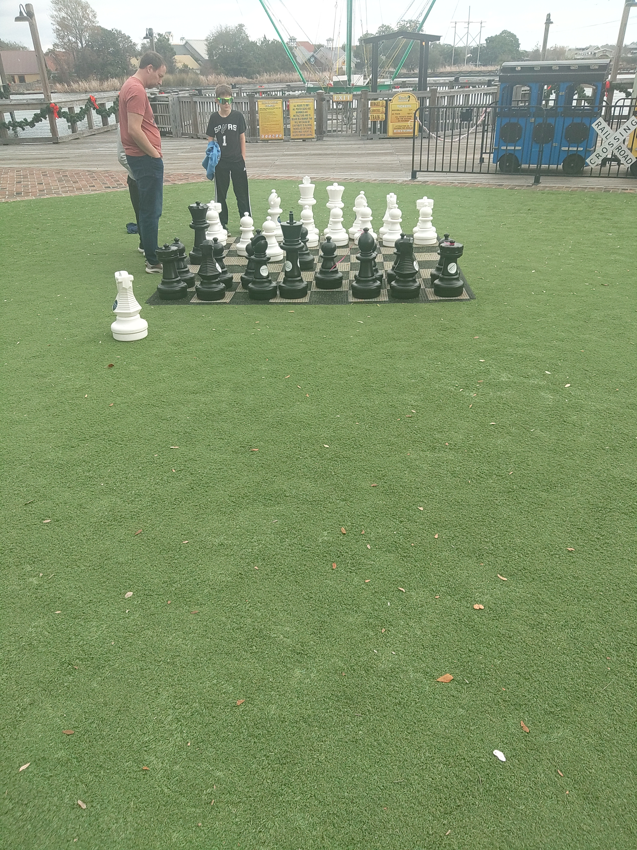
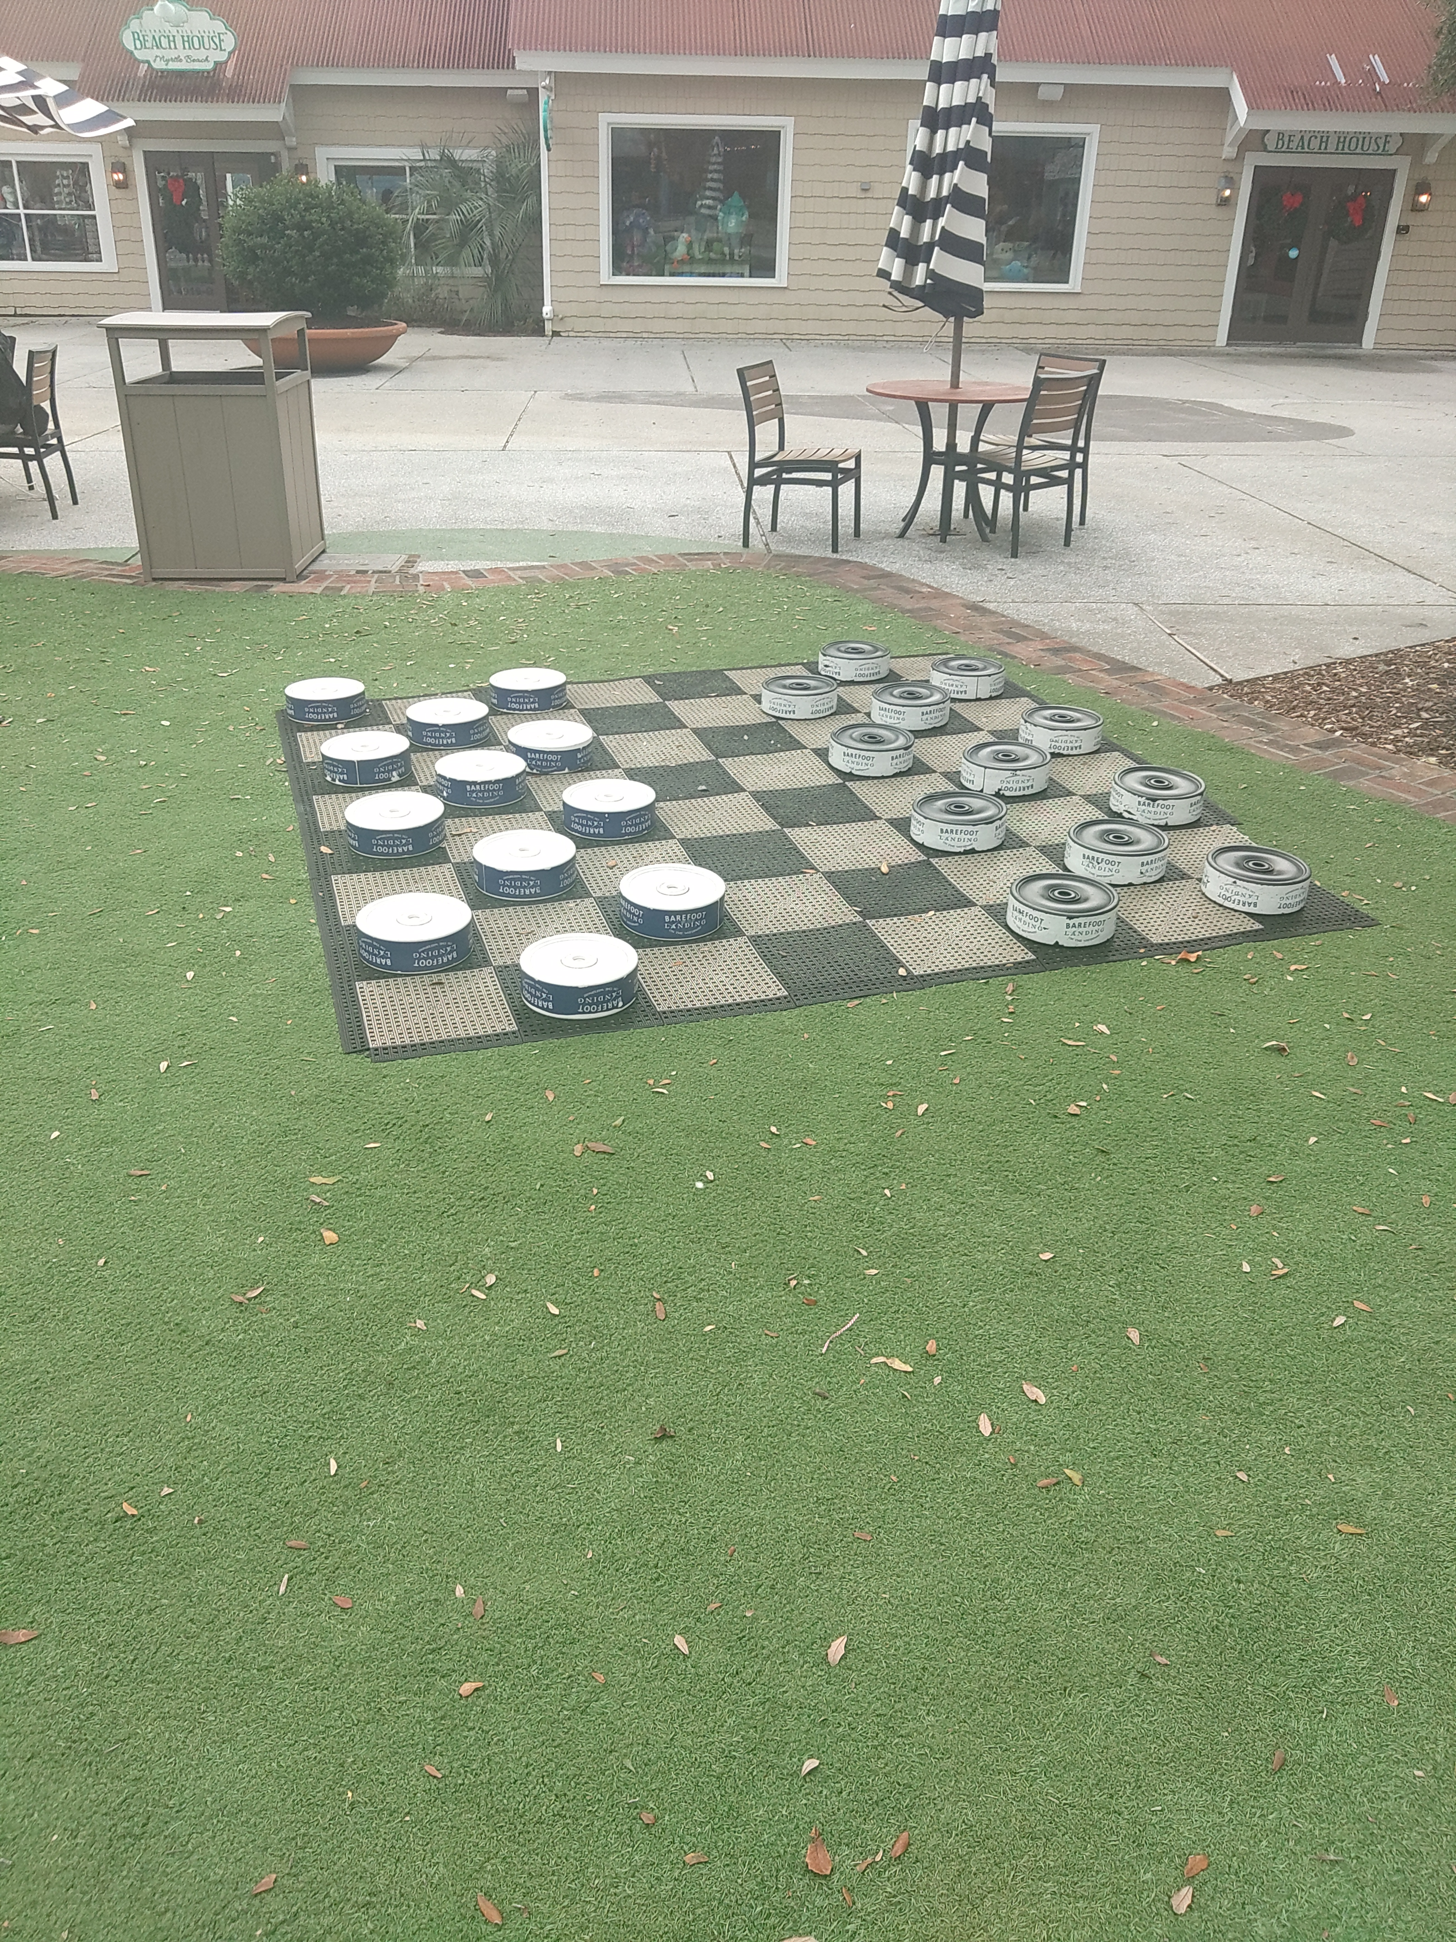
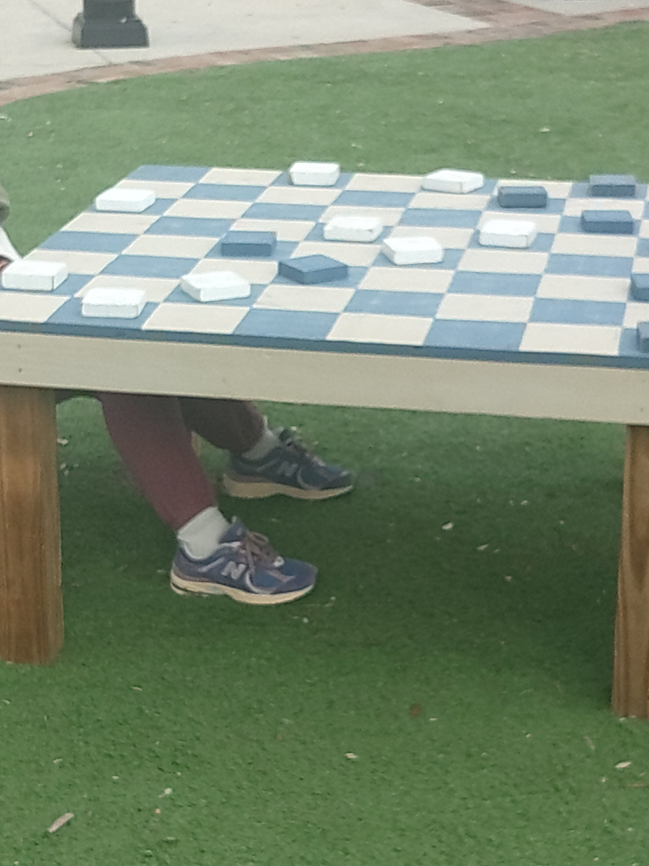
CORN HOLE PROJECT
Game Table Samples Shown.
Cement walkways attach everything.
4-foot walkways to accommodate wheelchairs.

Slide 4
Proposed location of corn hole and game tables

Slide 5
PARKING LOT – PHASE 2
Preliminary Plan for Phase 2 Parking Lot
Proposed 170 parking spots

Slide 6
Thank you!
Questions from Council?
Voting on Item #1 – Corn Hole Project – Go forward with two cornhole courts and game tables.
Voting on Item#2 – Approving Preliminary Plan for Phase 2 of the Parking Lot.

