Slide 1
Town of Millville, Delaware
Presentation of Financial STATEMENTS
August 11, 2026
For
April 30, 2026

Slide 2
Opinion
Pages 1 through 3 of the Basic Financial Statements
  Unmodified
    Highest level of opinion Certified Public Accountants can give
Pages 43 and 44 of the Basic Financial Statements
  Report on internal control over financial reporting and on compliance and other matters
    Not an opinion report
    We did not identify any material weaknesses or significant deficiencies in internal control over financial reporting
    We did not identify any instances of noncompliance that we were required to report under Government Auditing Standards

Slide 3
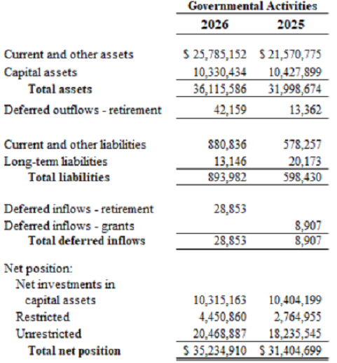
Statement of Net Position
Notes:
Net pension asset of $33,000 is new in 2026. Included in current and other assets.
Deferred outflows – contributions made into the pension plan beginning July 1, 2025 through April 30, 2026. They will be recognized as an expense in FY27 when the pension report is available. Measurement date vs fiscal year is always different.
Deferred inflows retirement – related to the pension plan.
3 classifications of net position on the government wide
Net investment in capital assets $10.3M, 29%. Assets less any debt on those assets.
Restricted includes transfer taxes, escrow funds held on behalf of others, municipal street aid grant, and impact fees held on behalf of the volunteer fire company.
Unrestricted – everything else. 58%. Can be used at the Town’s discretion.

Slide 4
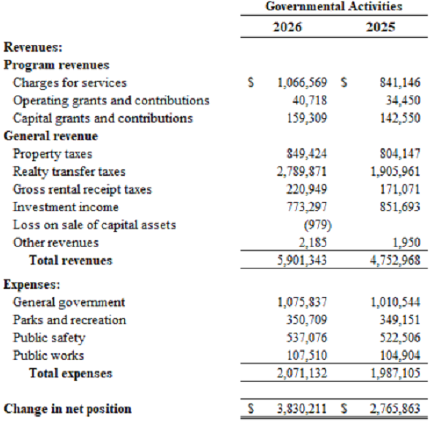
Statement of Revenues, Expenses and Changes in Net Position
Notes:
Net position increased $3,830,000 compared to $2,766,000 in 2025.
Revenues increased by $1,148,000 – increase in charges for services ($225,000), increase in transfer taxes ($884,000), increase in rental receipt taxes ($50,000)
Expenses increased by $84,000 – increase in gen govt ($65,000), increase in parks and rec ($1,600), increase in public safety ($15,000), increase in public works ($2,600)

Slide 5
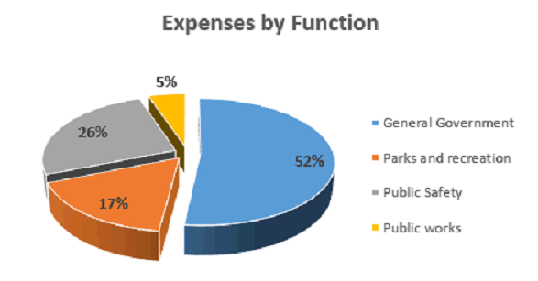
Governmental Activities- Expenses
Notes:
Gen Govt 52% $1,075,837
Parks and rec 17% $350,709
Public Safety 26% $537,076
Public Works 5% $107,510
Common allocation that we see between departments. Gen govt is the largest usually followed by public safety.
Gen govt is the largest – costs to run the Town.
Public safety is the second largest – ambulance fees, police services from state of DE.

Slide 6
General Fund
- Budget Comparison Schedule starting on page 36
- Actual amounts were favorable compared to the budget by $3,636,029
  This is a combination of revenues and expenses
    Revenues are over budget $2,466,000, largely due to taxes by $1,765,000 followed by investment income by $273,000
    Expenses are under budget by $1,170,000. Various expense categories experienced savings, specifically general government by $943,000 and capital outlay by $287,000.
- Net change in fund balance for 2026 was an increase of $3,888,029 compared to an increase of $2,586,848 in 2025.
- Unassigned fund balance totaling $19,827,527 or 80% of general fund
fund balance.
  GFOA recommends, at minimum, the general fund have no less than two months of operating expenditures in unassigned fund balance.
  Restricted fund balance includes transfer taxes, escrow funds held on behalf of others, municipal street aid grant, and impact fees held on behalf of the volunteer fire company.
  Committed fund balance includes funds held for economic development, the future police department, and long-term reserves.
Notes:
Unassigned is well over the minimum recommended. Two months would be $336,000 based on 2026 general fund expenses.
In talking with Will and Eileen there are significant expenses coming in the future for park improvements and a possible police department – wages, taxes, benefits, pension, vehicles, equipment, building, etc. This would create significant expenses in all future years.

Slide 7
GASB 68, Delaware Public Employee’s Retirement System Update
- Pages 30 through 31 of the footnotes.
- Liability is measured as of June 30, 2025, the latest audit available from the pension system and actuary information.
- Contributions were $19,423 during the year ended April 30, 2026. The Town has consistently fully funded the required contribution for the retirement plans.
Notes:
Town was active in the plan beginning 7/1/24. The fiscal year and measurement date differ due to the states year-end being June 30. Measurement date for the pension is June 30, 2025.

Slide 8
Auditor Communications
Management Letter on Pages 1 and 2.
  Review and approval of journal entries
  Year-end financial close process
  Adjustment for investment account activity
Required Auditor Communications with Those Charged with Governance on Pages 3 through 6.
Notes:
We always identify management override of controls through journal entries as a significant risk, all audits regardless of the client. A formal process for preparing and reviewing journal entries was created in FY26 after our recommendation in the prior year. Review and approval was not consistently performed and documented during the year. We recommend documenting the review and approval for all journal entries by having the Town Manager or another appropriate individual other than the individual responsible for recording journal entries.
Year-end financial close – prior year revenues and expenses were not closed into the current year. We recommend management implement procedures to ensure that all year-end closing entries are reviewed and recorded in a timely manner. A formal closing checklist and review process should be established to verify that all closing entries. Discussed with Will, and he has Edmunds closing checklist available to do a final close of the year-end following the audit.
Adjustments for investment account activity – we recommend recording adjustments to reflect the change in investments each month to record the interest income earned. Will has already implement this and has recorded interest for the three months so far in FY27.
Auditor Communications – include a lot required language on our end. Includes our responsibilities for the audit, material audit adjustments, any disagreements with management, new accounting standards implemented during the year, etc.

Slide 9
Current Accounting Pronouncements
GASB Statement No. 102, Certain Risk Disclosures, will be effective for the Town beginning with the year ending April 30, 2026. This statement establishes requirements to disclose certain risks faced by governments.
Notes:
No significant impact to the Town financial statements.

Slide 10
Future Accounting Pronouncements
GASB Statement No. 103, Financial Reporting Improvements, will be effective for the Town beginning with the year ending April 30, 2027. This statements will improve key components of the financial reporting model to enhance its effectiveness in providing information that is essential for decision making and assessing the government’s accountability.
GASB Statement No. 104, Disclosure of Certain Capital Assets, will be effective for the Town beginning with the year ending April 30, 2027. The statement will provide guidance on how to disclose right-to-use assets resulting from leases, subscriptions and PPPs to promote consistency and comparability between governments. It also provides new disclosure requirements related to capital assets held for sale.
Notes:
103 – changes to some items that are required to be presented in the management’s discussion and analysis and in the budget to actual required supplementary information.
104 – will change the presentation in the footnotes for the Town’s leased equipment. More enhanced disclosures but won’t be a significant change.

Slide 11
Questions
Notes:
A lot of information. In conclusion, the Town is in very good financial condition. No major concerns or difficulties from us.
Thank Will and Eileen and all other staff that assisted with the audit.
We appreciated their cooperation and addressing our many questions. First year with a new auditor can be tough but they really made it as smooth as possible and made anything available to us that we needed.

