Slide 1
Evans Park Game Tables
BY: Eric Evans

Slide 2
Game Table Project
Suggestion -- Concrete for durability vs Metal
Cement walkways attach everything. No trimming needed.
4-foot walkways to accommodate wheelchairs.
Prefer the concrete tables, longer lasting. Metal tables will still need the same amount of concrete under.

Slide 3
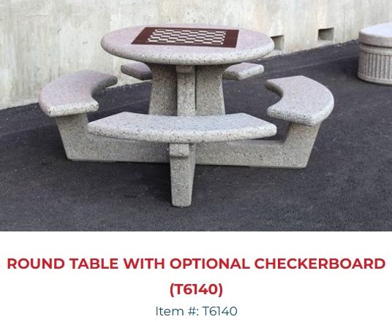
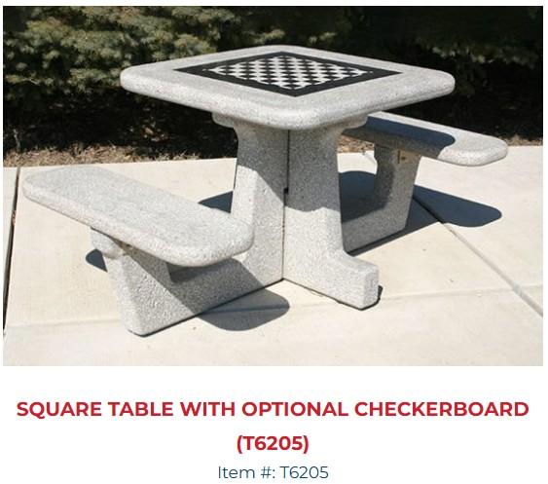
Concrete Tables T6140 and T6205
QUOTED PRICE
$1,855.00
Game Table Samples Shown.
Cement walkways attach everything.
4-foot walkways to accommodate wheelchairs.
T6140 – Round table with checkerboard.
68” Diam. / cement 140” diam.
T6205 – Square table with checkerboard
68” Square / cement 140” square
QUOTED PRICE
$1,630.00

Slide 4
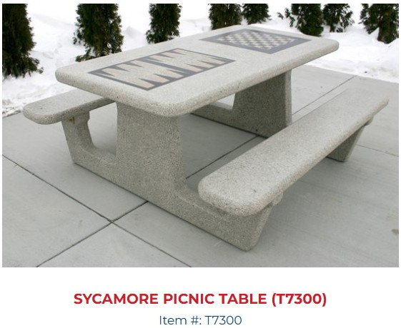
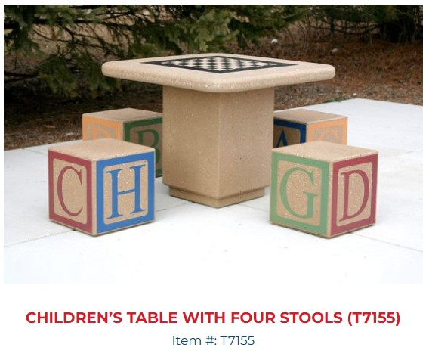
Concrete Tables T7300 and T6060
QUOTED PRICE
$2,395.00
Game Table Samples Shown.
Cement walkways attach everything.
4-foot walkways to accommodate wheelchairs.
T7300 – Rectangle table with backgammon & checkerboard.
72” x 68” / cement 144” x 140”
T7155 – Square table with checkerboard
36” square x 27” high
NON-QUOTE PRICE
$1,720.00 + cost of stencil chairs (more child size)

Slide 5
Metal Table
Metal Table Sample Shown
Cement walkways attach everything.
4-foot walkways to accommodate wheelchairs.
Matches other similar in park. Will secure with concrete. Can get square or round table.
Model H-7951(Sq) or H-7952 (round) 152” Diam. / 46” size
NON-QUOTE PRICE
Square $1,230.00 Round $1,250.00

Slide 6
Closer Image – Location of tables
Circles represent tables. Square is corn hole.

Slide 7
Thank you!
Questions from Commissioners?
Making a motion to move ideas to Town Council for approval.

